Slide 1

SOW
Farming is not a Profession…!!!
It’s a Passion…!!!

Slide 2
Problem Statement:
Diseases in cash crops cause major production and economic losses as well as reduction in both quality and quantity of crop.
Lack of awareness for the farmers about new diseases cause widespread of the diseases and incurs huge losses on cash crop.
Drastic change on climatic behavior causes indefinite effects on cash crop cultivation.

Slide 3
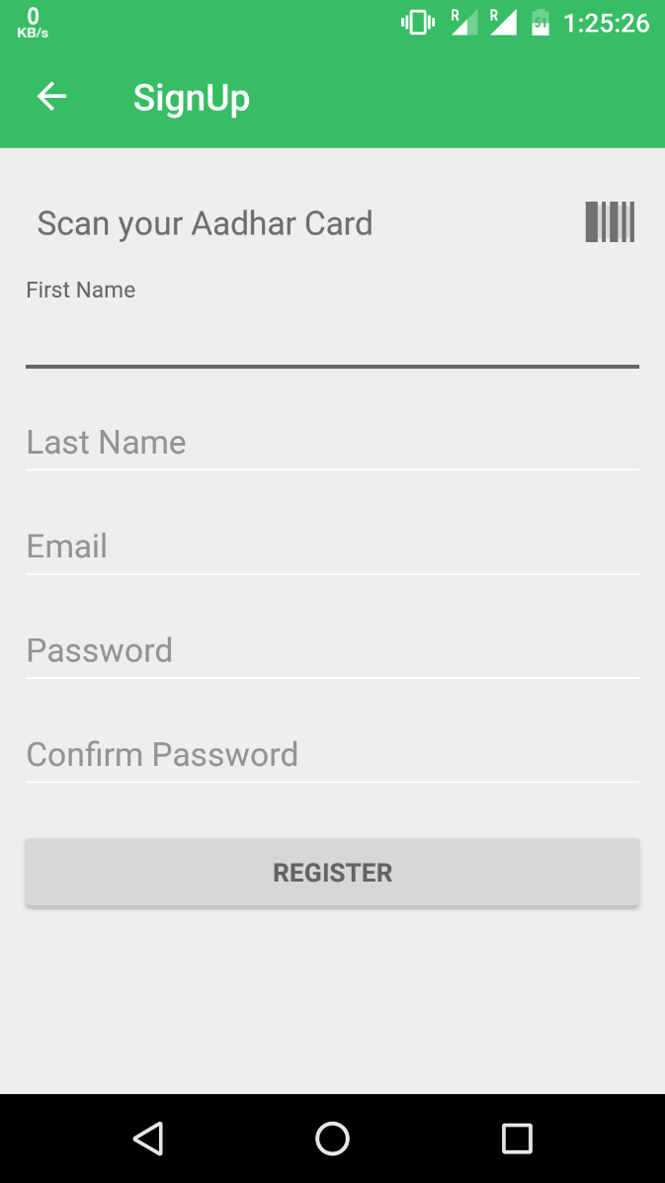
LOGIN AUTHENTICATION
For Authentication Purpose, login can be performed in two ways ,
Login using mail id and password.
By scanning aadhaar card Bar code a farmer can register in it.

Slide 4

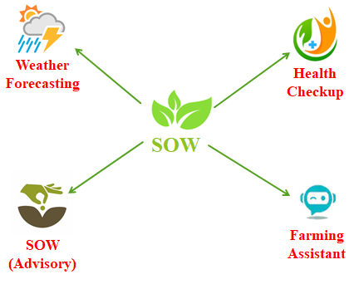
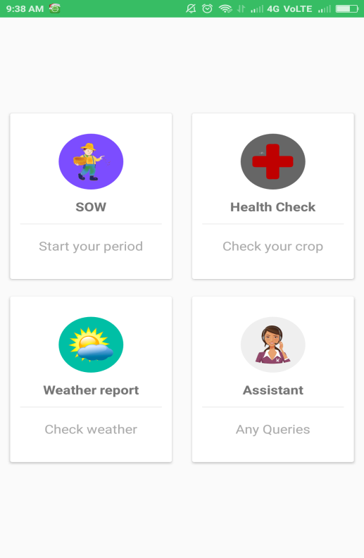

APP Features:

Slide 5
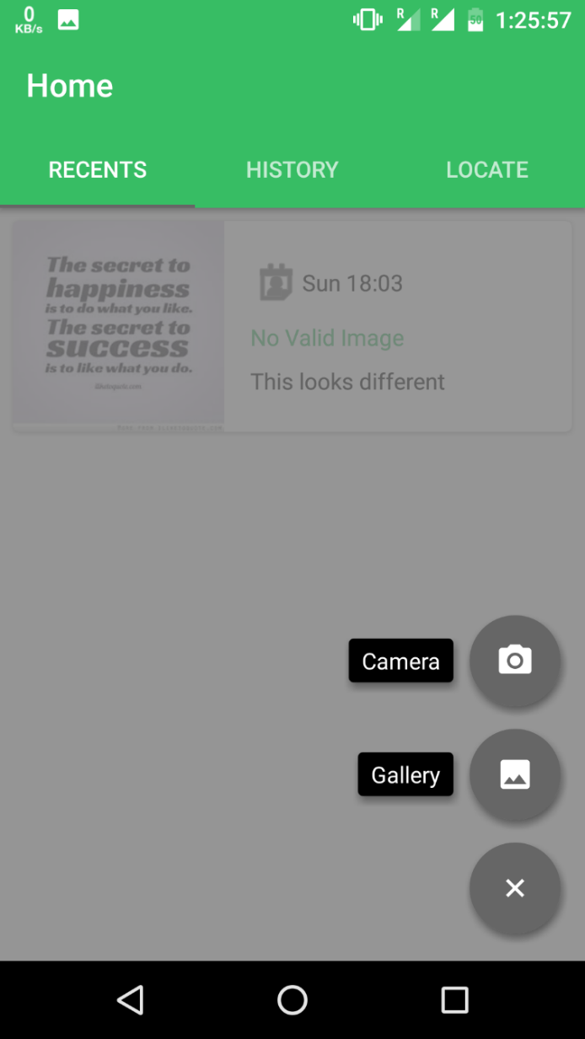
IMAGE PROCESSING:
The crop image is either captured directly from application or from the gallery.
The selected crop image is processed by Convolutional neural network(CNN).

Slide 6
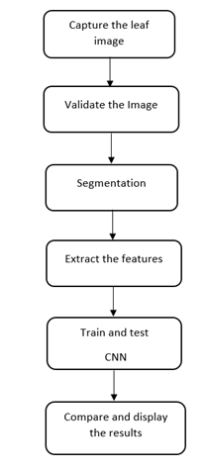
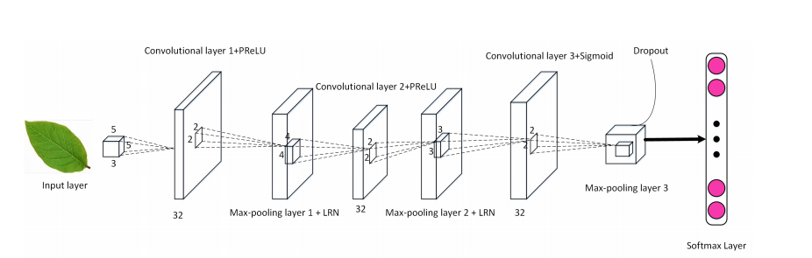
CONVOLUTIONAL NEURAL NETWORK
Convolutional neural networks are deep learning algorithms that are particularly powerful for analysis of images.

Slide 7
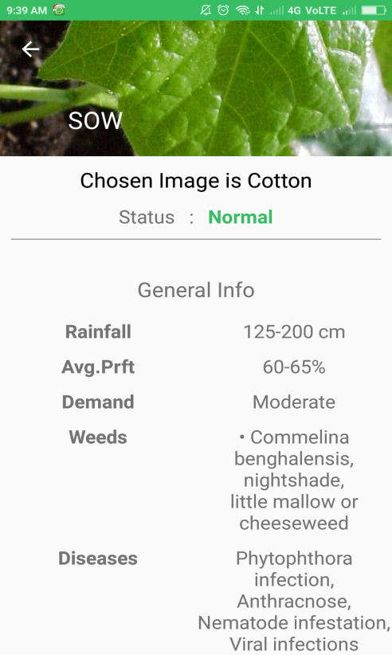
GENERAL INFORMATION:
If it is free from any defect then the general information of specific crop will be provided.
The system captures and presents every single detail of the crop in a simplified manner, providing a comprehensive overview of its growth and development

Slide 8
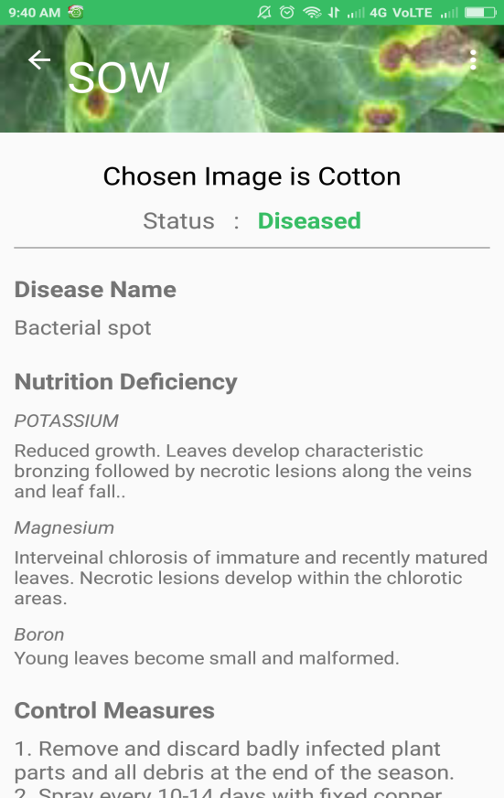
DISEASE DESCRIPTION:
If the crop is found to be defective, the system will identify the specific nature of the defect.
Additionally, the system provides measures to mitigate the impact of newly emerging diseases.

Slide 9

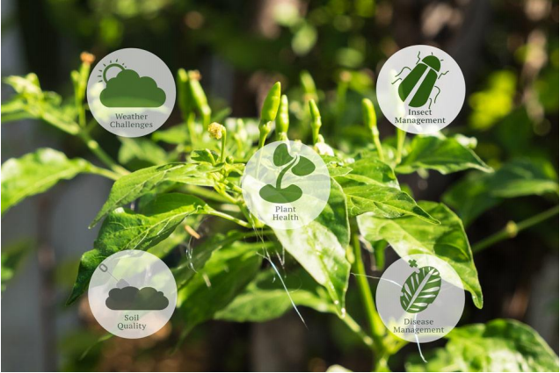

PREDICTION AND ANALYSIS:

Slide 10
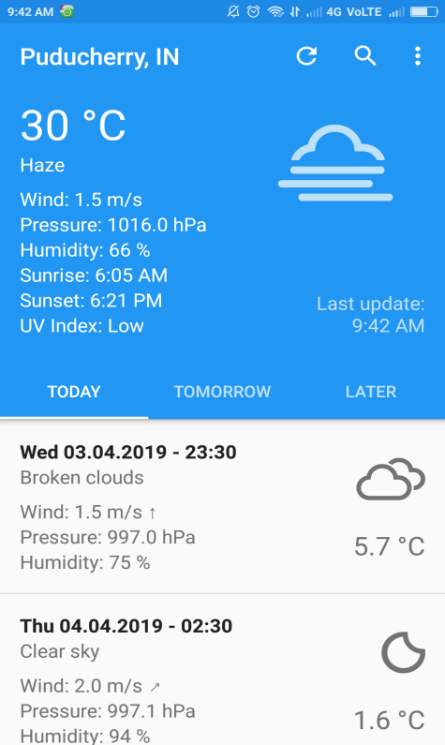
WEATHER PREDICTION:
By predicting the weather farmers are instructed when to apply the fertilizers or herbicides into the field.
So that the fertilizers are not wasted and farmer can use it for more than a week.

Slide 11
DISEASE PREDICTION:
For every stages of crop, diseases that may occur will be notified with image and symptoms so that farmers can make health prediction of crop using ML in their field.
This will increase their yield rate and finally produces yield rate for that crop

Slide 12
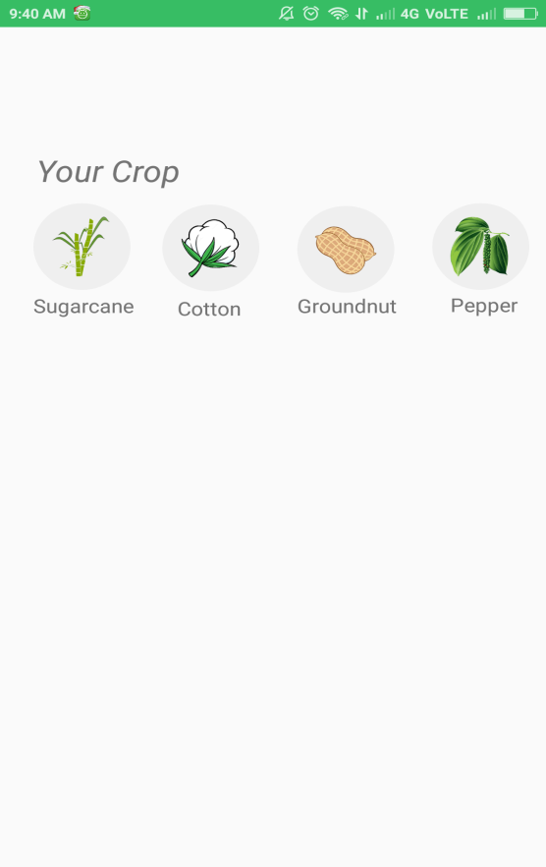
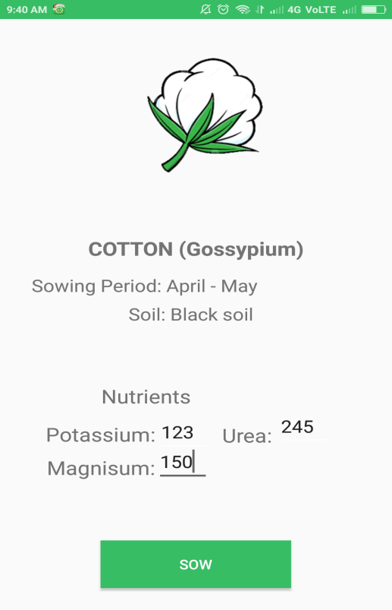
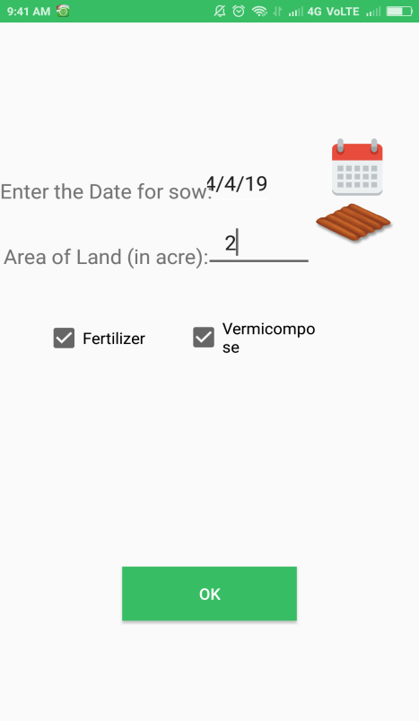
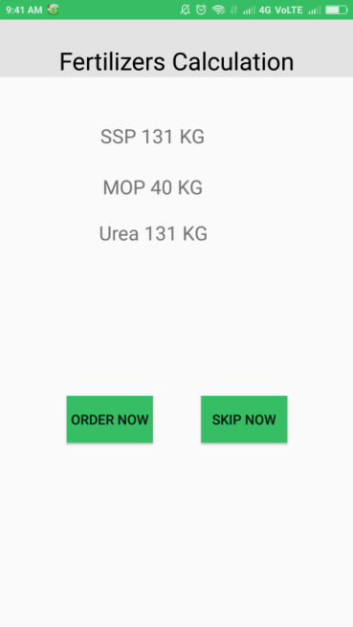
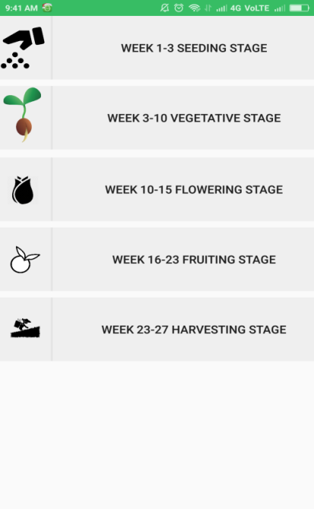
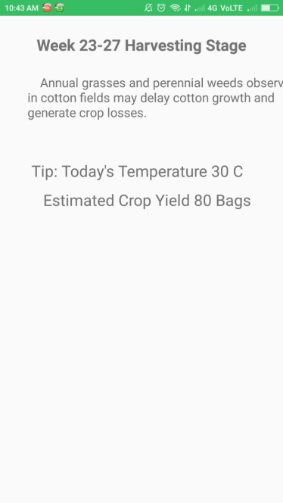

Slide 13




Technological Stack
Python
Keras
Kaggle
Google Cloud

Slide 14
THANK YOU

